Slide 1
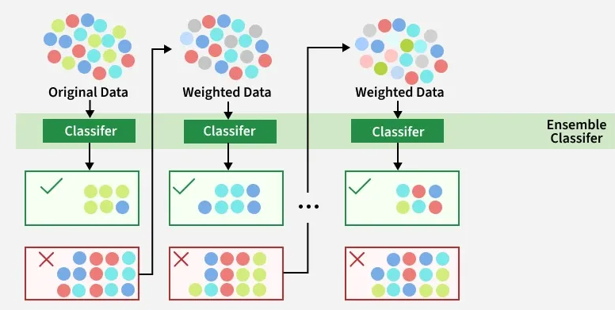
Boosting Algorithm
AdaBoost Algorithm (Adaptive Boosting ):
AdaBoost an ensemble learning technique that combines multiple weak models to create a strong predictive model.
It works by adding the model sequentially to correct the errors made by previous model by adjusting the weight to the misclassified data point.

Slide 2
Advantage:
High Accuracy: Often produces better results than single decision tree by adjusting the weights
Simplicity : Simple to implement and Understand
Robustness: Good for Smaller, cleaner dataset
Disadvantage:
For large data set, slower to train than some other methods because of its sequential.

Slide 3
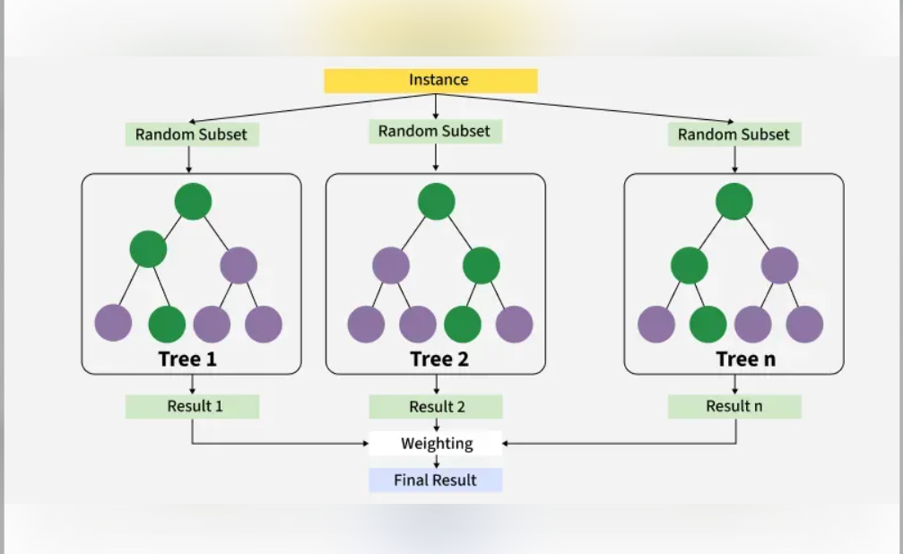
XGBoost Algorithm
XGBoost Algorithm(eXtreme Gradient Boosting):
XGBoost an ensemble learning technique that combines multiple weak models to create a strong predictive model.
XGBoost uses decision trees as its base learners and combines them sequentially to improve the model’s performance. Each new tree is trained to correct the errors made by the previous tree and this process is called boosting.
It has built-in parallel processing to train models on large datasets quickly.

Slide 4
Advantage:
High Performance & Accuracy: Often superior in structured data tasks, frequently used to win Kaggle competitions.
Built-in Regularization: Includes L1 (Lasso​) and L2 (Ridge​) regularization to control model complexity and reduce overfitting.
Handles Missing Values: Automatically learns the best split direction for missing data, eliminating the need for imputation.
Speed & Scalability: Utilizes parallel computing and cache-aware algorithms for faster training on large datasets.
Flexibility: Supports custom loss functions and evaluation metrics, suitable for various regression problems
Disadvantage:
High Computational Cost: Training can be intensive and slow, especially on very large datasets with deep trees.
Overfitting Risk: If hyperparameters (e.g., max_depth, learning_rate) are not tuned properly, it can easily overfit noisy data.
Complex Hyperparameter Tuning: Requires extensive tuning of parameters like learning rate, subsample, and colsample_bytree to achieve optimal results.
Low Interpretability: The ensemble nature of the model makes it a "black-box," making it harder to explain compared to linear regression.
Memory Usage: Can have high memory consumption, as it may need to load the entire dataset into memory

Slide 5
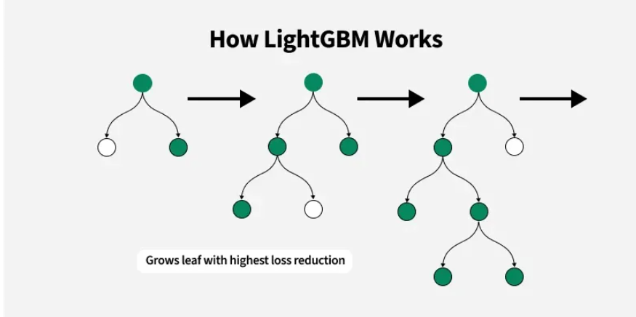
LGBoost Algorithm
LGBoost Algorithm(Light Gradient Boosting):
LGBoost an ensemble learning technique that combines multiple weak models to create a strong predictive model.
It's designed for efficiency, scalability and high accuracy particularly with large datasets. It uses decision trees that grow efficiently by minimizing memory usage and optimizing training time. Key innovations like Gradient-based One-Side Sampling (GOSS), histogram-based algorithms and leaf-wise tree growth enable LightGBM to outperform other frameworks in both speed and accuracy.
The main objective is to minimize the loss function

Slide 6
Advantages of the LightGBM Algorithm
Faster Training Speed & Higher Efficiency: LightGBM is significantly faster than other algorithms like XGBoost due to its leaf-wise splitting method and use of histogram-based algorithms.
Lower Memory Usage: It is optimized for memory efficiency, enabling it to handle large datasets with minimal overhead.
Better Accuracy: The leaf-wise growth approach helps in creating more complex, deeper trees that can capture intricate patterns in the data, often leading to state-of-the-art predictive accuracy.
Handles Large Datasets Effectively: Its optimizations make it well-suited for big data applications where other algorithms may struggle with computational expense.
Parallel and GPU Learning Support: The algorithm supports parallel and GPU accelerated training, further enhancing its speed and scalability.
Efficient Handling of Categorical Variables: LightGBM uses categorical feature binning, which is more efficient and accurate for high-cardinality categorical data than traditional one-hot encoding. ​
Disadvantages of the LightGBM Algorithm
Prone to Overfitting on Small Datasets: The leaf-wise growth strategy, while accurate, can lead to the model becoming too complex and overfitting the training data when the number of observations is small.
Complexity in Hyperparameter Tuning: LightGBM has numerous hyperparameters, and finding the optimal combination can be challenging and may require extensive experimentation.
Less Interpretable: The deeper and more complex trees resulting from the leaf-wise growth strategy can make the model more difficult to interpret and understand compared to simpler models or algorithms that grow trees level-wise.
Sensitive to Outliers/Noise (General Boosting Trait): Like other boosting algorithms, it can be sensitive to noisy data and outliers, as each subsequent model focuses on correcting the errors of the previous ones

